Slide 1
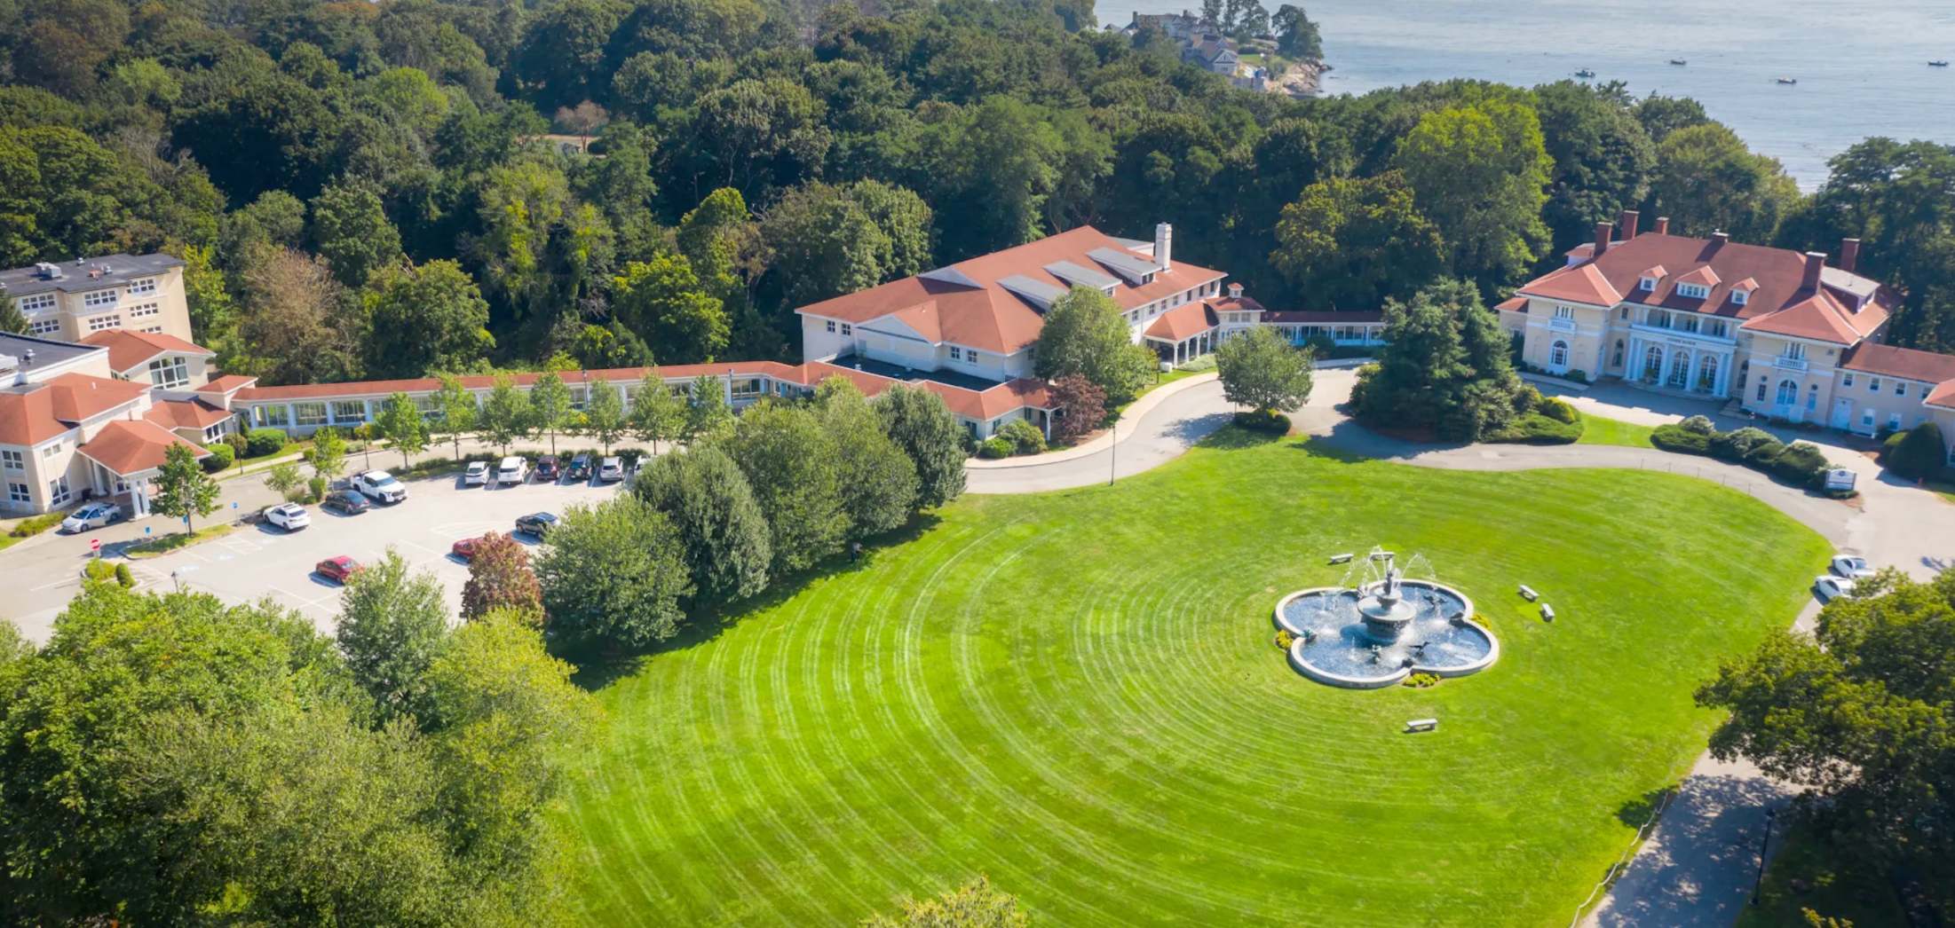
August Review
CHM Warnick / Wylie Inn and Conference Center
All materials and methodologies are copy written and protected Intellectual Property of Kate Burda & Company and for the express purpose for Wylie Inn and Conference Center, systems, and constructs are not for external distribution and are protected.

Slide 2
Executive Summary
EXECUTIVE SUMMARY
August 2026
⚡ STR: August RevPAR Index 108.2, up 17 pts
💻 Website Revenue: $30,222 | Visits +25% YOY
9,956 visits and 78 bookings generated $30,222 in revenue, up 15% YOY. Organic Search led with 30 bookings and $13,873, up 65%.
Occ 81.2% vs. comp 78.1% (MPI 104.0). ADR $198.60 vs. $190.95 (ARI 104.0) while the comp set cut rate 6.6%. Transient rate held; group drove the occupancy gain.
PPC delivered 15 bookings at 9.50x ROAS, bookings up 200% YOY. PMAX returned 4.37x on $474 spend, down from 11.57x in July.
🌐 Website Traffic +25% YOY: 9,956 Visits
🤖 AI Visibility: on 4 of 5 AI platforms
9,956 visits in August, the highest in 12 months. Organic Search and Direct led. AI Assistant referrals doubled to 200 sessions, up from 99 in July.
Wylie Inn appears on all five tracked AI platforms at 10-16% visibility. Sentiment averages 77%. AI mentions rose 33% to 3,924 in August.
WHY THIS MATTERS
August RevPAR beat the comp set by $12 a room: rate held while the market discounted, and group filled the house at $217.
Note: STR from the August STAR report; website and paid from the August O'Rourke report; GBP and AI visibility from Search Atlas (Jul–Aug).

Slide 3
STR Performance
August 2026 | Competitive Set Benchmarking

Slide 4
STR PERFORMANCE: August 2026
STR AT A GLANCE
August 2026 STAR report
Fiscal YTD (Jul–Aug): Occ 78.7% vs. comp 76.3% (MPI 103.1) | ADR $190.34 vs. $191.49 (ARI 99.4) | RevPAR $149.76 vs. $146.19 (RGI 102.4, +12.5%)
OCCUPANCY
ADR
REVPAR
Current Month
Growth
Wylie Inn
Growth
Growth
Wylie Inn
81.2%
+1.9%
+13.1%
+11.0%
$198.6
$161.4
Competitive Set
Competitive Set
Competitive Set
78.1%
$190.9
-3.6%
+3.2%
-6.6%
$149.1
Index (vs. 100 = Fair Share)
Index (vs. 100 = Fair Share)
Index (vs. 100 = Fair Share)
104.0
104.0
+9.1%
108.2
+17.4%
+7.6% vs. last year
Running 3-Month | Occ 76.0% (MPI 101.9) | ADR $193.25 (ARI 97.2) | RevPAR $146.86 (RGI 99.1) | Running 12-Month RGI 89.1, up 14.4%
WHY THIS MATTERS
Wylie beat the comp set on occupancy and rate while the market cut ADR 6.6%. RevPAR index 108.2, up 17 pts on last year.

Slide 5
Transient Rate
DID WE GIVE UP TRANSIENT RATE?
August 2026 | STR segmentation
No. Transient rate held while the comp set cut rate. What we traded was transient volume, and group took those rooms at a higher rate.
ADR CHANGE VS. LAST YEAR
AUGUST BY SEGMENT (WYLIE VS. COMP SET)
TRANSIENT
-1.2% ADR vs. $187.80 (-6.6%)
$177.30
ARI 94.4, up 5.8%
Occ 37.3% vs. 66.8%: rooms went to group
GROUP
+1.4% ADR vs. $209.50 (-1.1%)
$216.70
ARI 103.4
Occ 43.9% vs. 11.3%: ~1,240 group room nights
TOTAL
+1.9% ADR vs. $190.90 (-6.6%)
$198.60
RevPAR index 108.2, up 17.4%
Occ 81.2%, up 11.0%
Fiscal YTD (Jul–Aug): transient ADR $172.40 (+0.2%) vs. comp $188.40 (-4.7%). ARI 91.5, up 5.1%: still under 100, but closing.
WHY THIS MATTERS
Group pays about $40 more a night than transient ($217 vs. $177). Shifting the mix to group raised both rate and revenue.

Slide 6
Expedia
EXPEDIA: MORE VOLUME, RATE HELD IN PEAK
Stays Jan 1 – Sep 26, 2026 vs. 2025
Expedia revenue is up 42% this year. The growth came from low-season volume (Jan–Apr). Peak-season Expedia rate is at or above last year.
EXPEDIA REVENUE BY STAY MONTH
$341.7K
2,692
$156
Revenue
Room nights
ADR
+42% vs. $241.1K
+48% vs. 1,823
-4.3% vs. $163
WHERE THE RATE GIVE-BACK IS
3-Night LOS promo (20/30% off): ~825 room nights at about $114, roughly 31% of Expedia nights. It drove Jan–Apr revenue to $91.5K vs. $38.0K last year.
DECISION FOR THE BOARD
Keep 3-Night LOS after Oct 31? And do we stack it with the Nov–Mar dynamic discount (up to 30%) and Black Friday (30/40%)?
*September to date (data through Sep 26). Source: Expedia Partner Central.
WHY THIS MATTERS
Watch: YTD Expedia ADR is $156 vs. the Expedia comp set at $180. Forward pricing is the reverse: next 28 days, $343 vs. $303.

Slide 7
Website Performance
August 2026 | Source: O'Rourke Digital Marketing Report
WHY THIS MATTERS
Transient rate is holding against a discounting market. Growing commission-free website bookings keeps more of that rate at home.

Slide 8
WEBSITE KEY PERFORMANCE INDICATORS
August 2026 vs. August 2025
9,956
78
121
$30,222
1.01%
Total Visits
Bookings
Room Nights
Revenue
Conversion Rate
+25% YOY
+11% YOY
-19% YOY
+15% YOY
-14% YOY
VISITS BY CHANNEL
REVENUE BY CHANNEL
Channel | Visits | Share
Organic Search | 3,419 | 34.7%
Direct | 3,273 | 33.2%
Referral | 1,150 | 11.7%
Paid Search | 1,103 | 11.2%
Cross-network | 697 | 7.1%
AI Assistant + other | 228 | 2.3%
Channel | Revenue | Bookings
Organic Search | $13,873 | 30
Paid Search (PPC) | $5,223 | 15
Referral | $4,656 | 11
Direct | $4,401 | 13
Cross-network (PMAX) | $2,070 | 9
WHY THIS MATTERS
Organic Search drove 30 bookings and $13,873, up 65% on last August. Google is sending paying guests at no commission.

Slide 9
PAID MEDIA PERFORMANCE
August 2026
GOOGLE PPC
PERFORMANCE MAX
843
$485.40
22.38%
$0.58
553
$474.05
16.03%
$0.86
Clicks
Spend
CTR
Avg CPC
Clicks
Spend
CTR
Avg CPC
-15%
-47%
+40%
-38%
15
$5,223
9.50x
9
$2,070
4.37x
Bookings
Revenue
ROAS
Bookings
Revenue
ROAS
+200%
WHY THIS MATTERS
PPC returned $9.50 per $1 with bookings up 200% on last August. PMAX fell to 4.37x from 11.57x in July: worth reviewing with O'Rourke.

Slide 10
Domain & SEO Analytics
August 2026 | Source: SEMRush
WHY THIS MATTERS
For every $1 spent on Google Ads in August, the hotel returned $9.50 from PPC and $4.37 from PMAX. PPC is carrying the paid budget.

Slide 11

YOUR DIGITAL PRESENCE AT A GLANCE
July–August 2026 | Source: Search Atlas / Google
GOOGLE BUSINESS PROFILE: JULY/AUGUST 2026 VS. PRIOR 60 DAYS
95,511
60,575
1,667
3,191
541
Profile Views
Search Appearances
Website Clicks
Directions Requests
Phone Calls
+98% vs. prior period
+148% vs. prior period
+46% vs. prior period
+6% vs. prior period
+2% vs. prior period
DOMAIN HEALTH
GOOGLE REVIEWS
PROFILE HEALTH
28
793
4.2
GBP Score
★★★★☆
48/100
Domain Power
Keywords
Room to improve
DR 35 · DA 32
52 in top-3
409 total Google reviews | as of Sept 28
Profile Complete
38%
5 ★
219 (53.5%)
11 open tasks pending
Citation Score
4 ★
99 (24.2%)
81/100
Strong local authority
7,277
95/100
Avg Local Rank
3 ★
53 (13.0%)
#11
Monthly Traffic
Technical SEO
Goal: top 5
Value: $6,131/mo
Top SEO pillar
2 ★
20 (4.9%)
Mobile Search
+155%
1 ★
18 (4.4%)
Mobile search impressions
Backlinks
⚠ 196 reviews unanswered (52% reply rate). Each unanswered review is a missed signal to Google and to future guests.
1,588
609 referring domains
WHY THIS MATTERS
95,500 people saw your profile on Google in July and August, nearly double the prior two months. It's only 38% complete, with 11 open tasks and 196 unanswered reviews.

Slide 12
HOW PEOPLE FIND YOU, AND WHERE THE GROWTH IS
Search Atlas Site Explorer, updated Aug 12, 2026
793
96%
4%
Organic Keywords Ranking
Traffic is Branded
Non-Branded Traffic
52 in top-3 positions, driving real bookings
People searching for Wylie by name
New guests who don't yet know your name. Growth lives here
TRAFFIC TREND: LAST 3 MONTHS
KEYWORD POSITION DISTRIBUTION
GOOGLE SERP FEATURES ACTIVE (JULY 15 CRAWL)
7,978
1–3
52 keywords
AI Overviews
21 queries
8,490
7,277
Revenue drivers: most clicks happen here
Google's AI summaries include Wylie Inn answers
4–10
33 keywords
Sitelinks
35 queries
Near the top: one push gets these to #1–3
Google shows multiple Wylie pages below the main result, a brand trust signal
11–20
32 keywords
One page upgrade moves these into the top 10
Knowledge Panel
15 queries
21–50
218 keywords
Google displays your property info card automatically
Requires new content to move up
Local Pack
10 queries
Jun 2026
Jul 2026
Aug 2026
51–100+
458 keywords
Appears in map-based local search results
919 kws
967 kws
793 kws
Long-tail, low priority
TOP NON-BRANDED KEYWORD OPPORTUNITIES
These are searches by people who don't know your name yet. Capturing them is new revenue
Keyword
Position
Monthly Searches
Type
Traffic Est.
Action
hotels in Beverly MA
2
590/mo
Non-branded
48/mo
Push to #1: top spot gets most clicks
conference venue North Shore MA
Not ranking
200+/mo
Non-branded
None
HIGH: build this page
Beverly MA wedding venues
1 ▲
110/mo
Non-branded
27/mo
Won: now #1. Keep the weddings page fresh
WHY THIS MATTERS
96% of search visits come from people who already know the Wylie name. Every non-branded search we win is a new guest, commission-free.

Slide 13
AI Visibility & Brand Perception
August 2026 | Source: Search Atlas LLM Visibility

Slide 14
AI Visibility and Brand Perception
AI VISIBILITY OVERVIEW
wyliecenter.com | August 2026 | Source: Search Atlas
13.6
5
793
609
AI Platforms
Organic Keywords
Referring Domains
overall visibility
Perplexity at 10%
Site Explorer, Aug 12
AI VISIBILITY SCORE
DISTRIBUTION BY LLM
Flat vs. July
Google AI Mode
14% · 82% sentiment
Wylie Inn appears on all five tracked AI platforms: Copilot 16%, ChatGPT, Gemini and Google AI Mode 14% each, Perplexity 10%. Sentiment averages 77.4%.
Gemini
14% · 82% sentiment
ChatGPT
14% · 76% sentiment
Holistic SEO Pillars (OTTO, grade 83/100): Technical 95/100 | UX Signals 62/100 | Content 33/100 | Authority 33/100
Copilot
16% · 82% sentiment
WHY THIS MATTERS
WHY THIS MATTERS
Wylie shows up in about 1 in 7 AI answers on its topics. Overnight stays leads at 52% visibility; the event topics are at zero.
Wylie shows up in about 1 in 7 AI answers on its topics. Overnight stays leads at 52% visibility; the event topics are at zero.

Slide 15
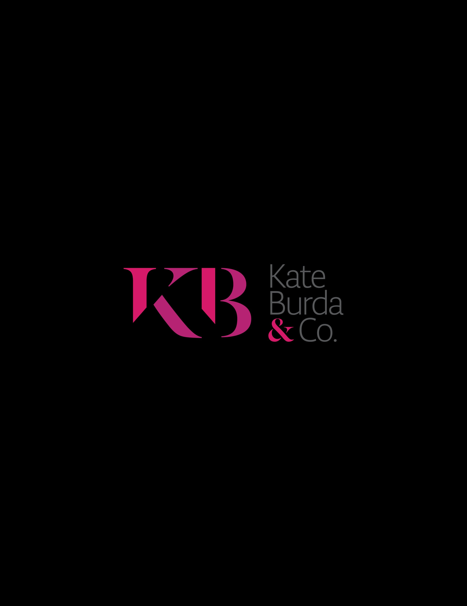
Brand Perception and Sentiment
AI BRAND PERCEPTION & SENTIMENT
August 2026 | Search Atlas
OVERALL SENTIMENT
BRAND INSIGHTS BY PLATFORM
WHAT AI SAYS ABOUT WYLIE
77%
Gemini
✅ STRENGTHS
82%
ChatGPT
Top topics by sentiment: On-Site Event Amenities (83%), Conference Event Services (83%), Event Venue Rental (81%), Overnight Guest Accommodations (72%), Meeting Room Facilities (68%).
76%
Favorable Sentiment
Google AI
82%
Google AI 82% | Gemini 82% | Copilot 82% | ChatGPT 76% | Perplexity 65%
Perplexity
65%
Positive on four of five platforms. Perplexity lags at 65%.
Mentions rose 33% in August (3,924 vs. 2,956). AI is talking about Wylie more; the next step is getting named in venue answers.
⚠ AREAS TO ADDRESS
TOP AI TOPICS
Guest rooms perceived as basic/dated
Limited dining options on campus
Inn side vs. Tupper Manor contrast
Inconsistent service quality mentions
Topic | Visibility | Mentions | Search Vol.
Overnight Guest Accommodations | 52 | 260 | 2.6K
Meeting Room Facilities | 16 | 152 | 2.7K
Event Venue Rental | 0 | 284 | 2.6K
Conference Event Services | 0 | 235 | 2.6K
WHY THIS MATTERS
AI speaks warmly about Wylie's event spaces (81-83% positive) but names Wylie in 0% of venue answers. Event content can close that gap.

Slide 16
Social Media Performance
July 2026 | Meta · Instagram · LinkedIn

Slide 17
Social Media
Meta · Instagram · LinkedIn | April/July 2026
📸 INSTAGRAM
💼 LINKEDIN
Account Views (2-month)
Follower Growth (2-month)
+20%
9.8k
Account back on track
Best Performing Content
Engagement Rate Change
+5.6%
Reel
Front Yard (Fountain Reel)
More traffic from content
Maximum reach came from a Reel featuring the property recap reel, engagement rate is 717, and with 1,641 views
LinkedIn account is gaining momentum. Next focus: relevancy and consistency to attract more targeted corporate and meetings-market traffic.
🔗 CONNECTING SOCIAL TO WEBSITE
Referral traffic to wyliecenter.com grew 100% MOM in last 2 months, a direct signal that AI-driven social discovery is increasing. Organic social drove 35 sessions. Brand awareness from Jawaria's posting cadence is measurably influencing AI-sourced referrals and overall site engagement.

Slide 18
Social Channels
Meta
LinkedIn
Instagram
Facebook
Account Views: 3.8k
Profile Activity: 19%
Maximum Reach/Trendy:
Last 60 days: 1.6k
Page View: 16%+
Search appearances: 31%+
Engagement rate: 2.1%+
Notes:
Our account reach for Aug is 2.4k which is 29.9% increase since last 2 months. Our maximum reach is a reel which is a short few second video clip of Wylie Inn (a guest who won a free stay at Wylie Inn) .
Linkedin account is getting back on track. We have 20% increase in our followers compared to last 2 months and 5.6% increase in engagement rate which means we are getting more traffic on linkedin account. For next month, our focus is more towards relevancy and consistency on page to attract more traffic.

Slide 19
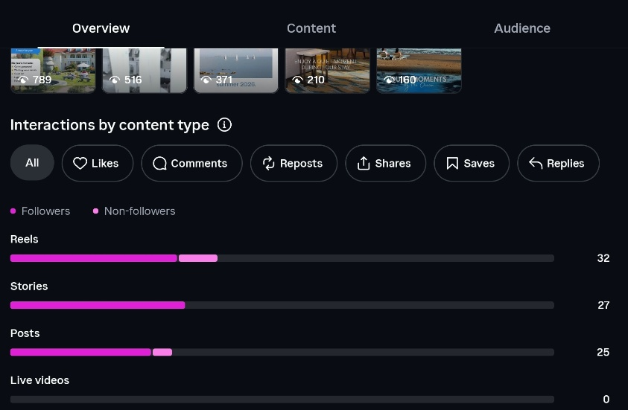
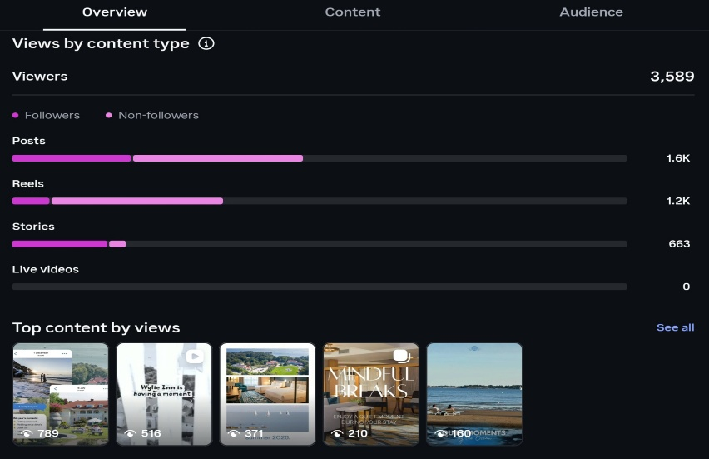
Insights

Slide 20
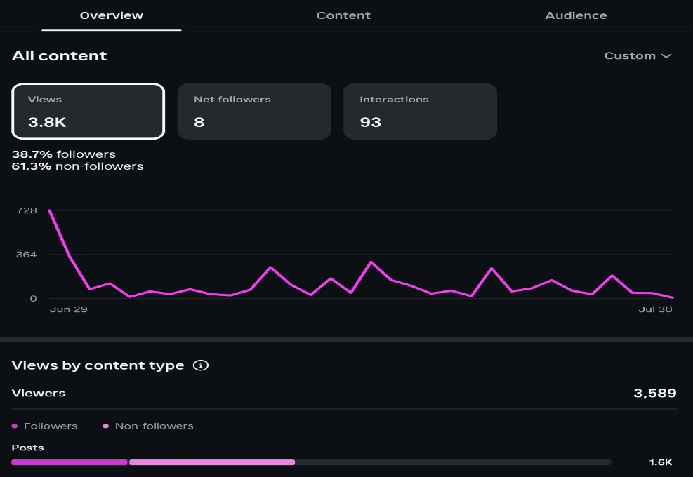
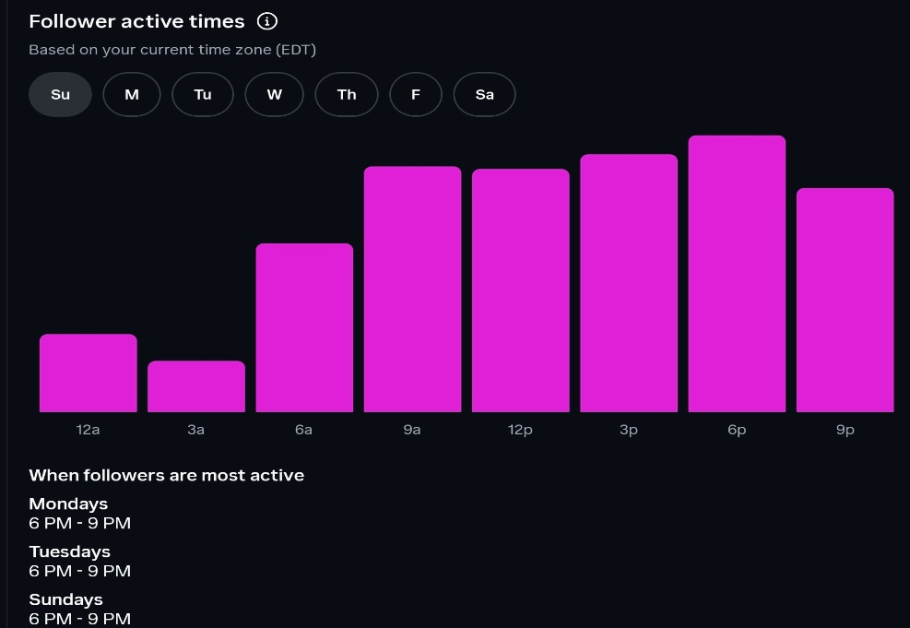
Insights

Slide 21
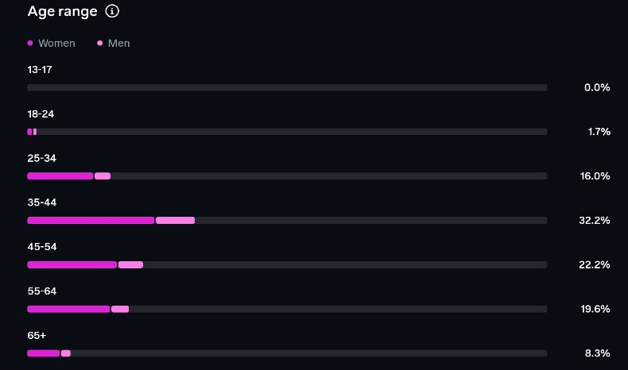
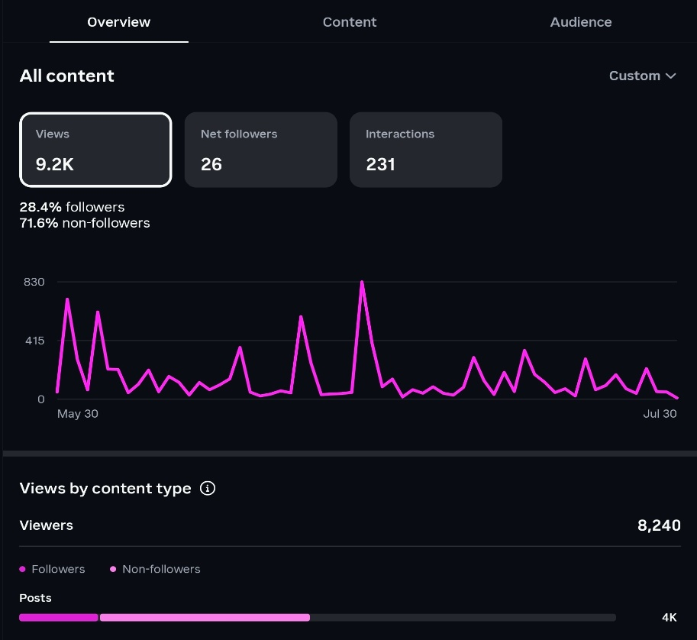
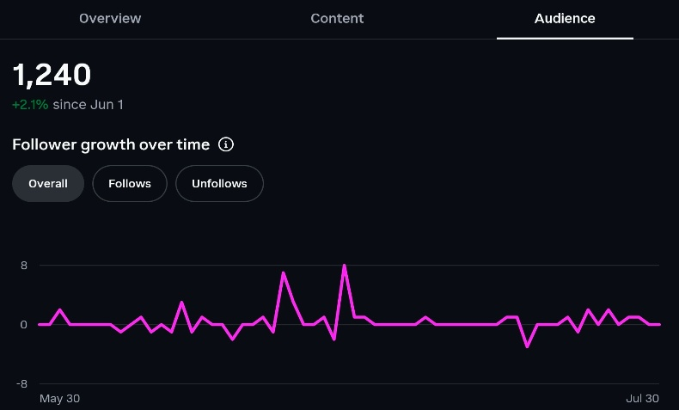
Insights

Slide 22
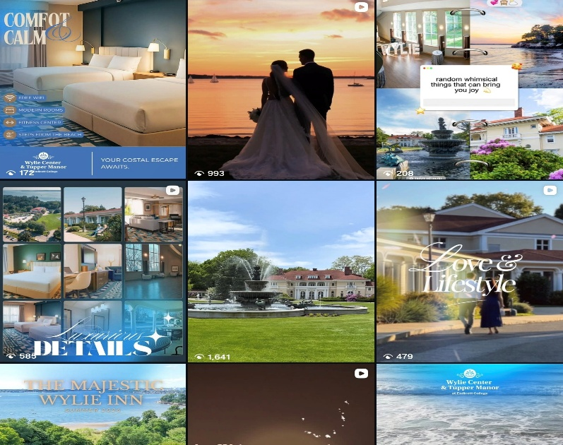
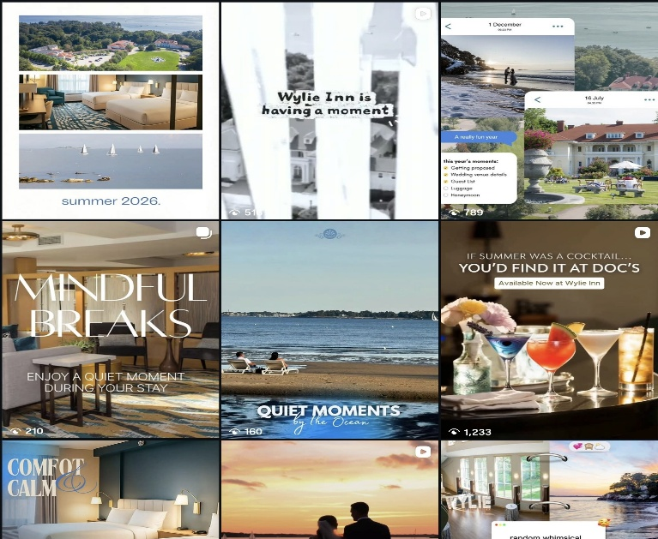
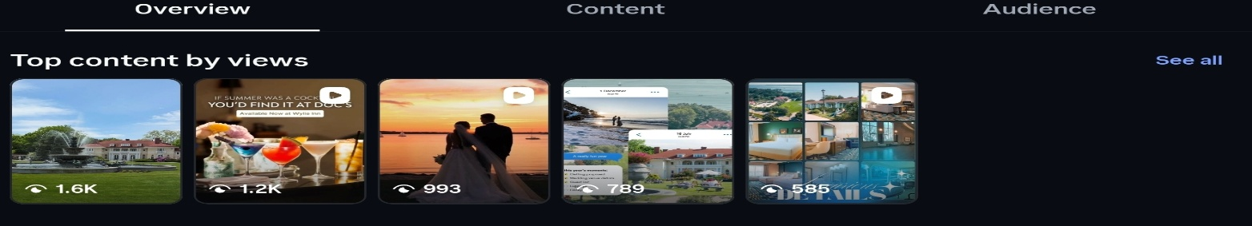
Insights

Slide 23
ACTION ITEMS & NEXT STEPS
Proposal
2026–2027
GBP Profile Optimization
ACTION
Renew and expand the Kate Burda & Co. engagement for 2026–2027 marketing and revenue management services.
11 pending tasks flagged in Search Atlas: add business description, open hours, services, photos (min 50), and social media link. Profile is only 38% complete, and each gap lowers local search rank.
Review Responses + AI Visibility
URGENT
Non-Branded Content & SEO
ACTION
196 Google reviews unanswered (52% reply rate). Responding to reviews directly improves local rank and AI sentiment scores. Enable automated review reply in Search Atlas to close the gap.
Content score is 33/100. 96% of search traffic is branded, so non-branded search is the growth lever. Priority keyword with no current ranking: 'conference venue North Shore MA' (200+ searches/mo). WordPress access needed to build content.

Slide 24
Thank you.
Prepared by Kate Burda & Co. | CHM Warnick

